Slide 1
Programming 4
13.1 Logical Programming
Semester 2, 2019

Slide 2
Logical paradigm
Tow basic terms used:
Logic – used to represent knowledge
Inference – used to manipulate knowledge
Largely based on formal logic
Metamathematics
Foundations of mathematics
Theoretical computer science

Slide 3
Prolog
Short for “PROgramming in LOGic”
Logical and declarative programming language
Associated with AI/ML and computational linguistics
Prolog is a type less language

Slide 4
Data types – terms
All Prolog data types are called term
Terms are either variables, atoms, numbers or compound terms

Slide 5
Subtypes – variables
Letters, digits and the underscore character
Anonymous variable:
has_a_child(X) :- parent(X, Y) = has_a_child(X) :- parent(X, _)
Start with an uppercase letter or the underscore character
Examples:
Cow
Sheep_123
_chicken

Slide 6
Subtypes – atoms
Letters, digits and the underscore character
Special characters
Characters enclosed with single quotes
Start with a lowercase letter
Examples:
cow
sheep_123
====>
<---->
‘Goat’
‘chicken’

Slide 7
Subtypes – numbers
The range of integer numbers is -16383 to 16383
The treatment of real numbers depend of the
version of Prolog
Real numbers are rarely used in Prolog
programming

Slide 8
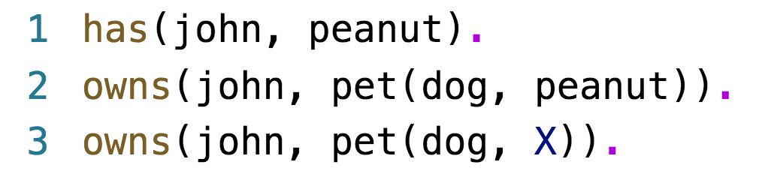
Subtypes – compound terms
Functor which is an atom
One or more arguments which can be any term

Slide 9
Relations
Specifying relationships among objects and
properties of objects
Example, “John has a car”
Declaring the relationship between two objects
Example, “Does John own a car?”
Trying to find out a relationship
Example, two people (X and Y) are sisters if:
They are both female and
They both have the same parents

Slide 10
Relations
We need to be careful how we phrase things
Constraints
Conditions
Example, X and Y are sisters if:
X and Y are both female
They have the same father and
They have the same mother and
X is not the same as Y

Slide 11
Facts, rules and queries
Declare facts describing explicit relationships
Define rules defining implicit relationships
Create queries by asking about relationships

Slide 12
Facts
John has the following cellphone number: 0271234567
In Prolog, it would be written as:
cellphone_num(john, 0271234567)
cellphone_num(john, 0271234567) is also called
a predicate or clause

Slide 13
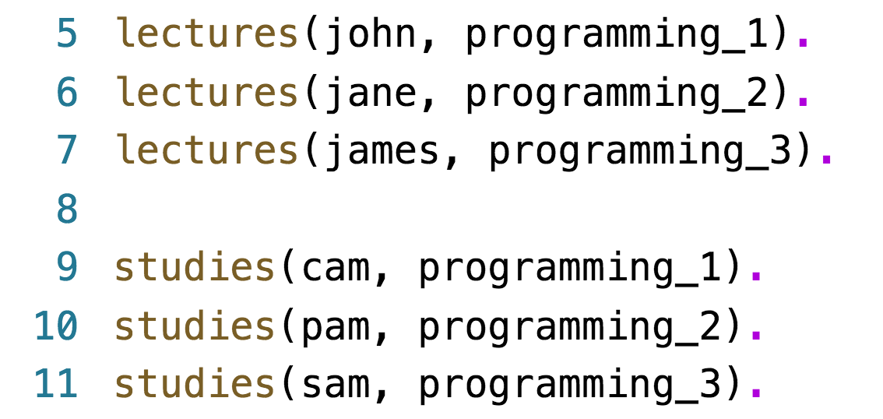
Facts
lectures(X, Y): lecturer X lectures paper Y
studies(X, Y): student X studies papers Y
Facts form Prolog’s database/knowledge base

Slide 14
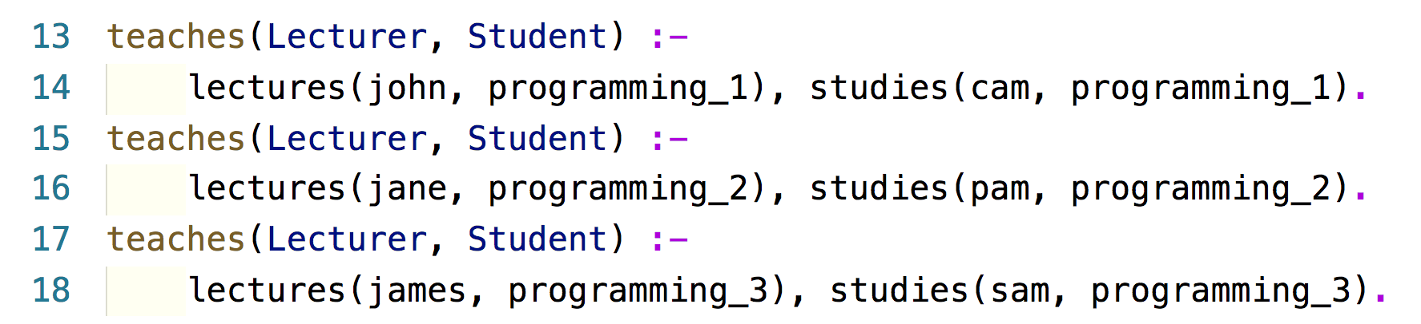
Facts
Facts are unit clauses and rules are non-unit clauses

Slide 15
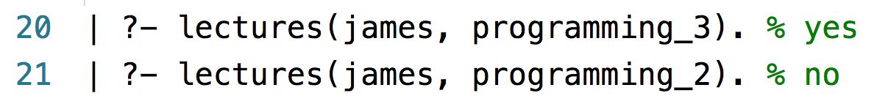
Queries
Based on facts and rules
Can ask questions based in the stored information
To satisfy a query, Prolog check if a known fact
is in the knowledge base

Slide 16
Queries
You are a choir conductor. In your choir, you
have sopranos, altos, tenors, and baritones.
Sopranos and tenors are upper voices
(the sing melody); altos and baritones are lower
voices (they sing harmony). You wish to perform
some duets, and for each, you want to choose one
upper voice and one lower voice
Find all the pairs of singers who can sing a duet

Slide 17
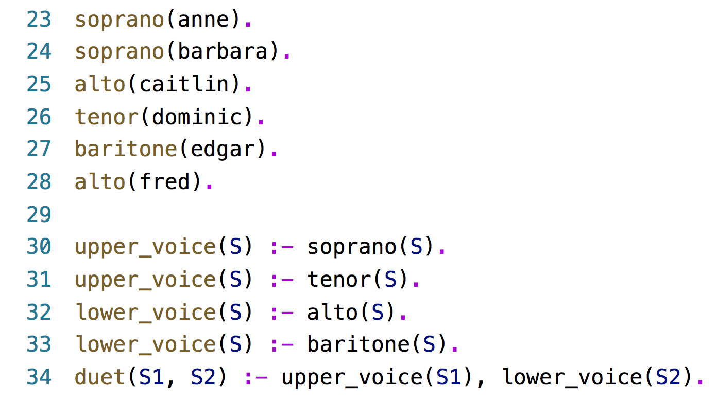
Example – queries

Slide 18
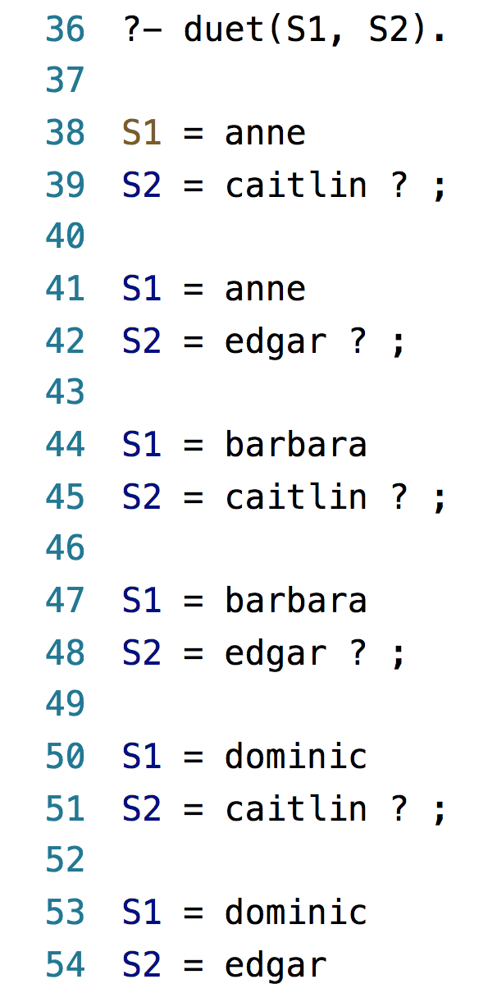
Example – queries

Slide 19
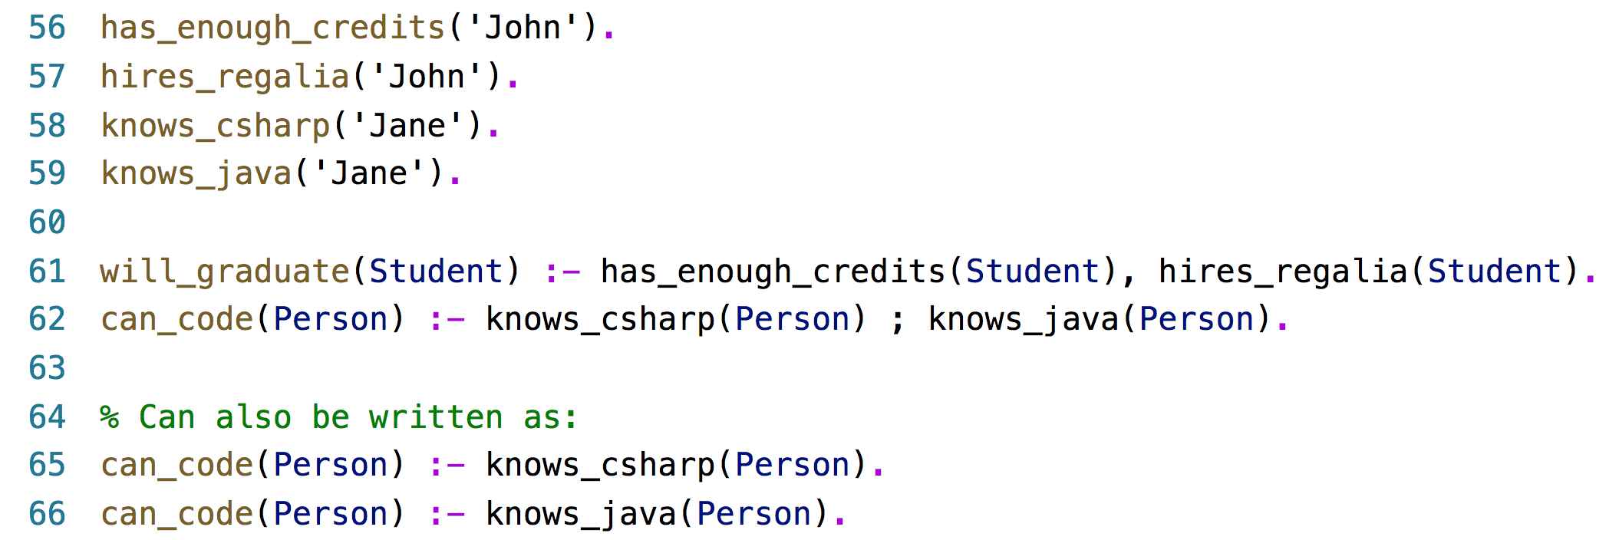
Syntax of a clause
“:-” means “if”. Also referred to the neck symbol
The left hand side of the neck is called the head
The right hand side of the neck is called the body
“,” stands for and/conjunction
”;” stands for or/disjunction

Slide 20
Operators
Operator | Description
=:= | Equal in value
=\= | Not equal in value
\= | Not (re. a property)
> | Greater than
< | Less than
>= | Greater than or equal to
<= | Less than or equal to

Slide 21
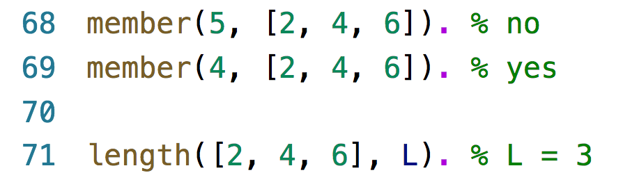
Built-in predicates

Slide 22
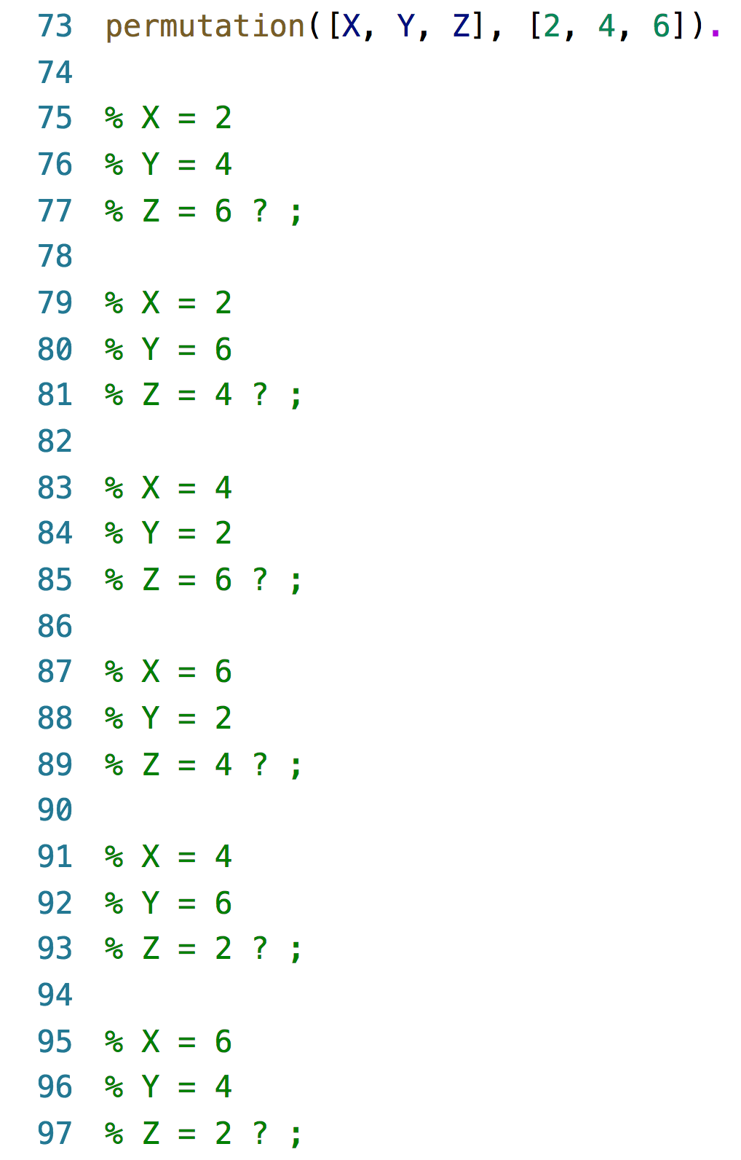
Built-in predicates

Slide 23
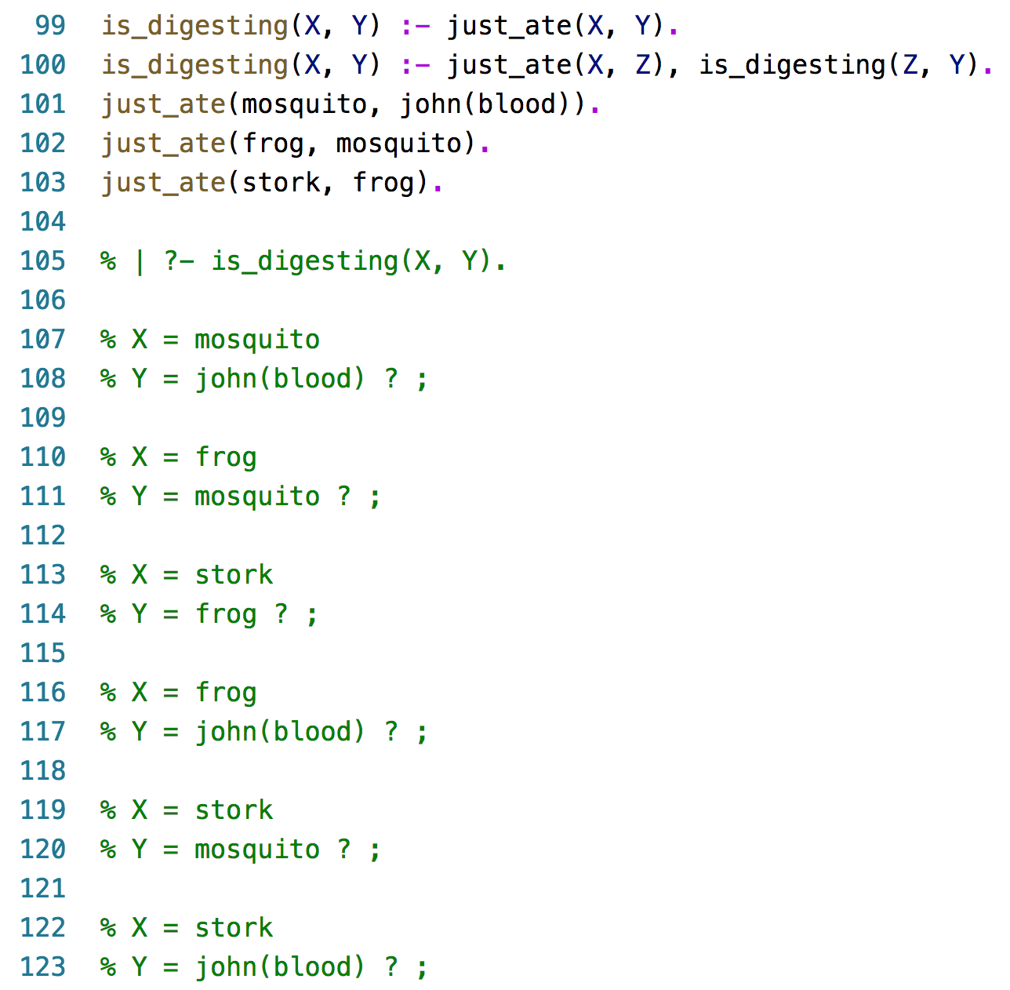
Recursion

Slide 24
Recursion
The dangers of recursion – failure to terminate
Recursive relations must have (at least) two
rules – base and recursive
Base must be reached – must come first in the knowledge base

Slide 25
Recursion
Apple
Amber
Eagle
Raise
V1
V2
H1
H2
Notes:
H1 – amber
H2 – eagle
V1 – apple
V2 – raise
H1 – apple
H2 – raise
V1 – amber
V2 – eagle

Slide 26
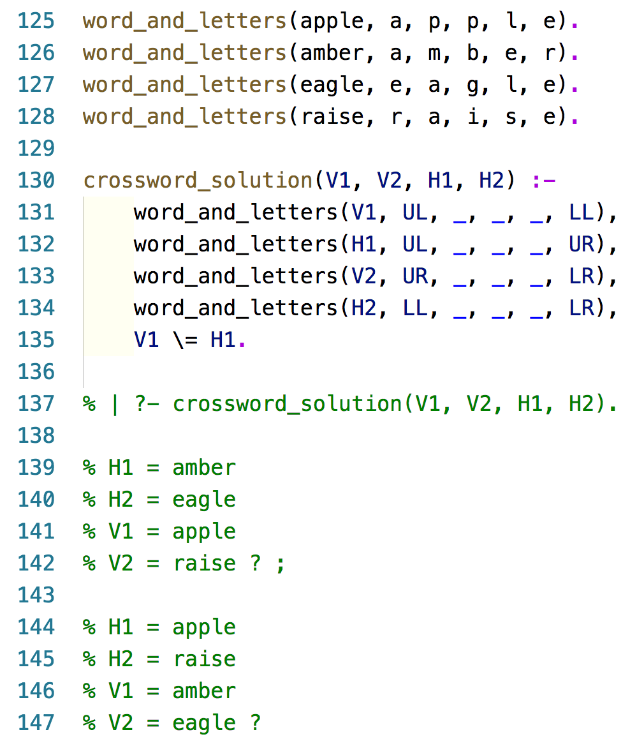
Example – recursion

